Slide 1
Compassionate Social Fitness:
Theory and Practice
Lynne Henderson
Shyness Institute
May 9, 2014
Monterey Bay Chapter of CAMFT

Slide 2
Overview
Social Fitness: Theory and Practice
The Model
    Three Vicious Cycles: Infinite Loops
    Testing:
ShyQ: shyness questionnaire; EOS: Estimations of Others
Notes:
Gilbert, P. (2010). Compassion Focused Therapy. London: Routledge.
Gilbert, P. (2007). Overcoming depression: Talks with your therapist. London: Robinson
Henderson, L. (2011). Building social confidence using compassion-focused therapy to overcome shyness and social anxiety. Oakland, CA: New Harbinger Publications, Inc..

Slide 3
Overview (cont.)
Social Fitness Training
CBT (Heimberg & Becker, 2002; Hope & Heimberg, 2010)
Changing negative attributions and self beliefs, reducing shame (Henderson & Zimbardo, 2001), beliefs about others and resentment (Henderson, 1998, 2014).
Shyness Clinic Research
Integrating Compassion Focused Therapy
(Gilbert, 2007, 2010, Henderson, 2011)
The Threat system, Drive system and Soothing System
Notes:
Gilbert, P. (2010). Compassion Focused Therapy. London: Routledge.
Gilbert, P. (2007). Overcoming depression: Talks with your therapist. London: Robinson
Henderson, L. (2011). Building social confidence using compassion-focused therapy to overcome shyness and social anxiety. Oakland, CA: New Harbinger Publications, Inc..

Slide 4
The Experience of Shyness
SAD FIXS
Self - Blame and Shame
Avoidance
Distress
Fear of Negative Evaluation
I Must, but I Can't!
X-posure: Fear of both Failure & Success
Self - Sabotage
Notes:
We define extreme or chronic shyness as a fear of negative evaluation that is sufficient to inhibit participation in desired activities or that significantly interferes with the pursuit of personal or professional goals (Henderson 1994). Extremely shy individuals and social phobics share either a phobic avoidance of social situations or marked inhibition when in these situations. Some of these individuals report feeling little distress but nonetheless fail to participate in a way that achieves social satisfaction; for example, rarely initiating conversations, failing to discuss their own interests, or being unable to respond directly to others.
Prevalence of shyness in the general population is between 50 and 60 percent (Carducci et al 2003). In a sample of adolescents who visited a shyness booth in a high school health fair, 61 percent reported that they were shy. Thirty percent of those who labeled themselves as shy tended to blame themselves in social situations with negative outcomes. This group demonstrated significantly greater fear of negative evaluation and social anxiety than the rest of the sample (Henderson and Zimbardo 1993). Prevalence of Social Phobia in community samples is currently estimated at 9 to 13 percent. Gender ratios have been generally reported as equal in normative samples of shy college students. Some samples of social phobics have suggested larger numbers of women than men, but these findings have been mixed. The gender ratio of clients presenting at the Shyness Clinic is 62 percent men to 38 percent women.
Your clients will present with inhibitory or avoidant behaviors (refusing to enter situations, becoming "invisible" in groups) or, less frequently, overactive behaviors (overcompensating for anxiety by excessive talking or “enacting” what are perceived to be favored behaviors instead of simply being themselves).
Your treatment goals will include bringing inhibited or overactive behaviors into a desired balance. You will sometimes urge clients to experiment with changing behaviors in order to see which ones seem to better suit their natural style. Sometimes behavioral changes affect the other domains of shyness and Social Phobia: physiological arousal, maladaptive thinking patterns, and negative emotions.
2. Physiological Arousal.
Your clients will complain of uncomfortable bodily sensations experienced in feared situations. These sensations include sweating, trembling, and racing heartbeats, etc.
Treatment goals are to help clients understand that their discomfort is very likely much less apparent than they believe, that they can behave as they wish socially even though they may experience anxiety while doing so, and, eventually, to reduce the intensity of physiological arousal as the client benefits from treatment. A goal to reduce physiological arousal should be translated into a concrete and specific goal, such as a reduction of a certain number of points on the Subjective Units of Distress Scale (SUDS; this scale, on which clients rate subjective anxiety on a scale from 0 to 100 at a given time or in a given situation, is described in session 2).
3. Maladaptive thinking patterns.
Shy clients tend to exercise thinking patterns which undermine their desire to feel more comfortable and to participate in difficult situations. These include simple cognitive distortions (for example, black and white thinking in which some particular performance which falls short of perfection is perceived by the clients to indicate that they are totally inadequate); maladaptive attributions (for example, shy people tend to blame themselves for perceived failures and to credit the situation for perceived successes); and distortions of the self-concept.
An important component of the treatment is to challenge maladaptive thinking patterns and to replace them with thoughts which are more likely to move clients toward their goals. This process is termed "cognitive restructuring," and is a major component of this approach.
4. Negative emotions.
Affect states such as embarrassment, shame, and guilt play a key role in promulgating a cycle of avoidance and anxiety.
Your treatment goal is to help clients understand how their emotional states affect their thoughts and behaviors, and to help them learn strategies for coping with these states.
These four domains constitute a dynamically interactive system. Changes effected in one domain sometimes bring about movement in other domains. Because the cognitive and behavioral domains lend themselves best to direct manipulation, treatment consists of exposures with cognitive restructuring, emphasizing specific attributional and self-concept restructuring for new situations and interpersonal skill-building for initiating and deepening relationships.

Slide 5
Perspectives: Integrated
Clinical
Practice
Research
design
reflect
treatment
test
analyze
question
measure
theory

Slide 6
Social Fitness Model
Addresses needs for emotional connection and agency
• Implies:
-satisfying interpersonal relationships,
-adequate emotion regulation,
-an adaptive cognitive style
• Implies the proactive pursuit of personal and professional goals.

Slide 7
Social Fitness Model (cont.)
• Involves frequent social exercise.
Many situations for practice and many kinds of behaviors considered adaptive.
• As golf, tennis, hiking, and jogging are means to stay physically fit, people join groups and communities, maintain close relationships, meet new people, cultivate friendships, and develop intimacy with a partner to stay socially fit.

Slide 8
Social Fitness: Cognition and Emotion
Adaptive thinking patterns and emotion regulation are important components of social fitness.
Shy individuals reverse the self-enhancement bias in social situations, blame themselves and others, and experience shame and resentment.
When one is ashamed, others appear contemptuous, when fearful, others look dangerous, when vulnerable, others appear powerful and potentially threatening.
Negative emotion and negative thoughts affect each other in an escalating reciprocal pattern.

Slide 9
Three Vicious Cycles
Fight/Flight
Shame/self-blame
Anger/other-blame
fear
shame
anger
negative
predictions
self-blame
other-blame
Approach
Avoidance
Resentment
Notes:
That caused me to add another vicious cycle to the two with which we were working. You can see that fear and negative thoughts about what will happen or may be happening reciprocally influence each other to the point the person may leave the situation and experience relief. Then, however, shame and rumination take over and the self-blame and shame escalate. Blaming others reduces it. The others could have been more considerate, more caring, more warm and inviting, more supportive, etc. They may even be seen as callous and cruel. Now the person is not only alienated from the self through the shame state, but now is also alienated from others who could potentially be a source of comfort and support. The next time they enter a social situation they may enter it more suspicious, more afraid and vulnerable, and less confident that social interaction can be rewarding. Clients cycle back and forth between these states and tend to ruminate obsessively. That is why we have them make two telephone calls a week to help each other challenge these negative thoughts, attributions, and beliefs about the self. It is easier to challenge others’ thoughts. Sometimes we can even ask. What would you say to a good friend who was feeling this way, and they can immediately respond with a more adaptive or rational response.

Slide 10
Three Compassionate Cycles
Face fear
Accept self
Accept others
accept fear
support self
support others
act through
emotion
self-compassion
compassion
toward others
Acceptance
Compassion
Forgiveness
Notes:
Lynne
Putting it all together: We accept our fear and act in the face of it. We accept ourselves and others, with all our imperfections, extending to both ourselves
and others compassion and forgiveness and a willingness to continue to engage in conversation until we understand each other better and can help each other be
the best that we can be as we work together.(do good work together?)

Slide 11
Blaming Others and Empathy:
High School Sample
● Perspective-taking is associated with adaptive interpersonal functioning.
● Empathic concern for others is associated with shyness.
● Blaming others is the ONLY significant negative predictor of perspective taking and empathic concern.
Notes:
Blaming Self and Others, Impact on Empathy; N=140
Self-blame, other-blame, shyness and private self-consciousness were used to predict empathy as measured by the perspective-taking and empathic concern scales of the Interpersonal Reactivity Index (Davis, 1983) .
Perspective-taking is "the tendency to spontaneously adopt the psychological point of view of others..." p. 113 and has been associated with adaptive interpersonal functioning.
Empathic concern "assesses 'other-oriented' feelings of sympathy and concern for unfortunate others..." p. 114
Blaming others was the only significant negative predictor of perspective taking t (2, 137) = 2.79, p. < .01; and empathic concern t (2, 137) = 4.29, p. < .0001.
You'll notice that blaming the other also reduces social anxiety, but it appears to have negative consequences. There is a growing literature on the emotional consequences of blaming others, including physical as well as emotional madajustment. Other blaming may interfere with planful problem solving, accepting responsibility, and positive reappraisals. Howard Tennen and Glenn Affleck have an extensive review in psych bulletin in 1990.

Slide 12
Social Fitness Training
Twenty-six Weekly Two-hour Cognitive-Behavioral Group sessions within an interpersonal theory framework
Daily Workouts
  Self-Monitoring, Self-reinforcement
Exposures with Cognitive Restructuring
  Changing negative attributions, beliefs about the self and others
Social Skills Training - the second 13 weeks: Reaching out
  Communication Training - Where do I go from here?
    Building intimacy - self-disclosure, handling criticism, conflict
    Expression of Feelings
    Empathy - listening
Attentional Focus Flexibility Training: self- other, empathic response
Video Taping, Mirror Wall
Notes:
Social fitness is analogous to physical fitness - we must work out to be in decent social shape. Few world class social athletes - most of us can work out in different activites to be competent and enjoy social well-being.
FEELINGS CHANGE as risks taken and thinking is challenged IN THE MOMENT - NOT INSIGHT, but TRANSFORMATION
self-change from critical to neutral; other - change from threatening to benign or less powerful, no-blame attribution style - empathy and accurate perspective taking

Slide 13
Stanford Students Changed Self-blaming Attributions and Reduced Shame in Eight-week Groups
Negative interpersonal outcomes:
Internal, stable and global attributions ⬇
Self-blame and state shame ⬇
Social anxiety ⬇ social avoidance and distress ⬇
trait shame ⬇ depression ⬇

Slide 14
Results
Self-blame
State-shame

Slide 15
Results
Internal
Global
Stable

Slide 16
Shame and Anger in Shyness:
Clinic Sample
● Shame predicts self-defeating behavior, passive aggression (MCMI).
● Shame is correlated with resentment and antisocial attitudes (MMPI).
● Clients with Avoidant Personality Disorder are:
more shame-prone,
more likely to externalize blame
Notes:
We analyzed data from our clinic sample to see how shame related to anger and negative behavior, and to see how blaming others might be operating in shy clients.
Shame was a significant predictor of MCMI scores on self-defeating behavior (N = 82) and passive aggression (N = 76).
Shame was correlated with resentment and antisocial attitudes as measured by the MMPI (N = 84)
Those diagnosed with Avoidant Personality Disorder were more shame-prone and more likely to externalize blame than other Shyness Clinic patients (N = 91).
Other-blame was measured by the Paranoia Scale (Pa) of the Minnesota Multiphasic Personality Inventory (MMPI). The presence of anger was assessed using three MMPI scales: Psychopathic Deviance (Pd) for resentment, Anger (ANGER) and Overcontrolled Hostility (O-H). These were correlated with scores on two shame scales, the Personal Feelings Questionnaire (PFQ) and the Test of Self-Conscious Affect (TOSCA). Scores on blame, shame and anger were then used to predict the degree of elevation on four Millon Clinical Multiaxial Inventory Scales: Social Avoidance, Self-abasement, Self-defeating Behavior and Passive-Aggressiveness. Shame was a significant predictor of elevated scores on the Social Avoidance, Self-abasement, Self-defeating Behavior and Passive-Aggressiveness scales. Resentment was a significant predictor of Self-Abasement, and ANGER was a significant predictor of passive aggression. Suppressed hostility was a significant negative predictor of Self-Abasement. Those diagnosed with Avoidant Personality Disorder scored significantly higher than the rest of the sample in other-blaming and shame.

Slide 17
Shame And Anger In College Student Sample
● Shame and anger in Stanford students
SHY students ⬆
NON-SHY students ⬇
Notes:
We also found that shame and suppressed anger were higher in shy vs. non-shy Stanford students.

Slide 18
Anger-supporting AT’s about Others (EOS): Students
  To what extent do you relate to each of these statements?
  Please make a rating on a 7 point scale from 1 (not at all) to 7 (very much).
Shy Non-shy
3.5 2.3 People will be rejecting and hurtful if I let them close to me.
3.3 1.6 People do not relate to my problems.
4.6 2.1 I must not let people know too much about me because they will misuse the information.
3.5 1.5 People are more powerful than I am and will take advantage of me.
3.2 1.8 If people see my discomfort they will feel contempt for me.
2.9 1.7 People will make fun of me and ridicule me.
Notes:
Items from EOS, estimations of others scale (AT’s about others)
To what extent do you relate to each of these statements?
Please make a rating on a 7 point scale from 1 (not at all) to 7 (very much).
Shy Non-shy
N= 15 27
3.6 2.5 1. ___People do not care about me.
3.0 2.2 2. x__When people see my discomfort they feel superior.
3.2 2.2 3. x__People do not identify with me when I am uncomfortable
3.5 2.3 4. x__People will be rejecting and hurtful if I let them close to me.
3.3 1.6 5. X__People do not relate to my problems.
3.9 2.4 6. X__If I'm not watchful and careful, people will take advantage of me.
4.6 2.1 7. X__I must not let people know too much about me because they will misuse the information.
3.5 1.5 8. X__People are more powerful than I am and will take advantage of me.
3.2 1.8 9. X_ If people see my discomfort they will feel contempt for me.
3.0 2.1 10. x__People are indifferent to my feelings and don't want to know about me.
2.9 1.7 11. X__People will make fun of me and ridicule me.
2.8 1.9 12. ___If I let people know too much about me they will say hurtful things to me, or talk about me behind my back to others.

Slide 19
Anger-supporting Thoughts and Beliefs
Shy Students vs. Clinic Sample
● Clinic clients ⬆
            Shy Students ⬇
Significantly Reducing AT’s about Others
EOS-Thoughts/Others N t p
M = 3.7; 3.1 (1-7) 99 5.86 .000
Notes:
SHY
Students Clinic patients
N=15 N=8
3.0 3.1 2. x_When people see my discomfort they feel superior.
3.9 3.1 6. X_If I'm not watchful and careful, people will take advantage of me.
3.2 3.6 9. X_If people see my discomfort they will feel contempt for me.
3.0 3.7 10. x_People are indifferent to my feelings and don't want to know about me.
2.9 3.7 11. X_People will make fun of me and ridicule me.

Slide 20
Challenging Negative Attributions and Beliefs about Self and Others
Choose challenging situation (SUDS 40 - 60)
Write it down
Imagine the situation does not turn out as well as you hoped
Identify at least four Negative Attributions and Beliefs, including both self and other
Write them down; Identify Distortions (p.3-4)
Challenge in Dyads (p.5); Develop a self-supportive response
Notice SUDS reduction and shame reduction
Notes:
Clients were able to reduce automatic thoughts about others as well as trait anger and suppressed anger.

Slide 21
The “Henderson/Zimbardo”
Shyness Questionnaire
    ● I blame myself when things do not go the way I want them to.
    ● I sometimes feel ashamed after social situations.
    ● I am usually aware of my feelings, even if I do not know what prompted them.
    ● If someone rejects me I assume that I have done something wrong.
    ● I tend to be more critical of other people than I appear to be.
Notes:
Henderson/Zimbardo Shyness Questionnaire ©
Please indicate, for each of the statements below, how characteristic the statement is of you, that is, how much it reflects what you typically think, feel, and do.
1. not at all characteristic 2. Somewhat 3. Often 4. Very 5. Extremely characteristic
._____I am afraid of looking foolish in social situations.
._____I often feel insecure in social situations.
._____Other people appear to have more fun in social situations than I do.
._____If someone rejects me I assume that I have done something wrong.
._____I tend to be more critical of other people than I appear to be.
._____It is hard for me to say “no” to unreasonable requests.
._____I do more than my share on projects because I can’t say no.
._____I find it easy to ask for what I want from other people.
._____I do not let others know I am frustrated or angry.
._____I find it hard to ask someone for a date.
._____It is hard for me to express my real feelings to others.
._____I tend to be suspicious of other people’s intentions toward me.
._____I am bothered when others make demands on me.
._____It is easy for me to sit back in a group discussion and observe rather than participate.
._____I find myself unable to enter a new social situations without fearing rejection or not being noticed.
._____I worry about being a burden on others.
._____Personal questions from others make me feel anxious.
._____I let others take advantage of me.
._____I judge myself negatively when I think others have negative reactions to me.
._____I try to figure out what is expected in a given situation and then act that way.
._____I feel embarrassed when I look or seem different from other people.
._____I am disappointed in myself.
._____I blame myself when things do not go the way I want them to.
._____I sometimes feel ashamed after social situations.
._____I am usually aware of my feelings, even if I do not know what prompted them.
._____I am frequently concerned about others approval.
._____I like taking risks in social situations.
._____If someone is critical of me I am likely to assume that they are having a bad day.
._____If I let people know too much about me they will gossip about me.
._____I think it is important to please others.
._____People feel superior when someone is socially anxious.
._____I spend a lot of time thinking about my social performance after I spend time with people.
. _____I am satisfied with my level of social support.

Slide 22
ShyQ.
(at www.shyness.com)
(Rating scale from 1, not at all characteristic of me to 5, extremely characteristic of me)
Web site respondents: M=3.6 (SD=.6)
Stanford students: M=2.5 (SD=.6)
Clinic Sample: M=3.6 (SD .6).
Chronbach’s Alpha for six samples=.92
Correlation with the Revised Cheek and Buss Shyness Scale (college samples) = .6 and .7 (Melchior and Cheek, 1990).

Slide 23
Henderson’s Research: Individualism Gone Awry?
Shyness may become a clinical problem because our society currently disavows and rejects sensitivity and cooperative and collaborative vs. dominant or aggressive behavior.
Shyness, particularly in males, is negatively stereotyped in the U.S. Shy females are stereotyped as traditional homemakers, not as achievers.
When someone is less competitive and more concerned about others’ evaluations, look at their motives and values as well as their behavior.
Notes:
Does shyness become a clinical problem because our society currently disavows and rejects sensitivity and cooperative and collaborative vs. dominant or aggressive behavior? Are the automatic thoughts about others and mistrust justified? Does our culture devalue and stereotype certain temperaments, just as it does people of different races, cultures, and ethnicities?
Shyness, particularly in males, is negatively stereotyped in the U.S. In fact, shy males compare themselves to hyped up media images of highly extraverted, self-aggrandizing, dominating, and aggressive males just as women compare themselves to hyper-skinny models and develop eating disorders. News reports are snide, such as the one “Captains of Industry and still can’t get a date” that appeared in the boom time in silicon valley.
But I would suggest that when someone is less competitive and more concerned about others’ evaluations, look at their motives and values as well as their behavior.

Slide 24
Are the Shy Exceptional Leaders?
Shy individuals may be our reluctant, socially responsible leaders of the future.
Jim Collins (From Good to Great ) studied outstanding CEO’s, called “level five leaders”. They successfully guided companies through times of intense change and challenge. Guess what? They were diffident, shy
I do not see many behavioral deficits in the Clinic. When people are accepted for themselves they demonstrate skilled social behavior.
Notes:
I think shy individuals have characteristic leadership styles that may differ from the way we see leaders in our culture. They may be equally charismatic, for example, contrast Nelson Mandela with George Bush. I propose that the shy may be our reluctant, socially responsible leaders,and their leadership may be particularly important for the future of our planet. I’ve observed that they lead from behind, take responsibility for failure, they listen, support and empower their employees. They can be fiercely determined to achieve a goal. They are considerate, collaborative, thoughtful, sensitive, and deep.
Jim Collins (From Good to Great ) called people like this level five leaders. They successfully guided companies through times of intense change and challenge. They are some of the world’s greatest leaders, often unknown. Abraham Lincoln was a shy young man who became one of our country’s greatest leaders. Eleanor Roosevelt was shy.
Courage implies that we do things in spite of being afraid.
I do not see many behavioral deficits in the Clinic. When people are accepted for themselves they demonstrate skilled behavior. Particularly when they can see they won’t be devalued for their shyness. It may be important to listen to their value systems and study their strengths. We’ve talked about strengths and leadership, Now let’s talk about sex. As one of Phil’s mentorees, I have learned how to make things relevant to one’s life.

Slide 25
Shy Leaders Study
Interview study of outstanding shy leaders:
Method: Face to face interviews which are transcribed by the author and coded by a research team to determine:
1) Interpersonal traits (Interpersonal Adjective Scale, IAS; Wiggins, 1995)
2) Interpersonal motives (Circumplex Scales of Interpersonal Values, CSIV; Locke, 2000)
3) Personality styles (Personality adjective check list, PACL; Strack, 2005)
4) Prototypical leadership styles
5) Leadership themes in interviews

Slide 26
Shy Leaders: Preliminary Findings
Shy leaders:
1. tend to lead from behind and let others take the spotlight.
2. are keen observers of people.
3. listen carefully and are empathic.
4. are motivated, persevering, strategic and genuine.
5. appear passionate about their values and their work.
6. over-prepare for public speaking tasks.
7. push past shyness to get the job done.
8. are collaborative.
9. appear androgynous, with both masculine and feminine traits.

Slide 27
Vision: A Shy Revolution
Clinicians see shyness as a disease, a belief encouraged by drug companies. I see a culture in trouble.
We need to focus on and nurture the strengths of those who are shy, starting in childhood in schools and families. We need to focus on their strengths in therapy.
We cannot afford to lose their participation in our democracy.
America is now known as one of the biggest bullies on the block. Terrorism and torture show us that everyone is vulnerable, and any of us can be bullies.
Notes:
Clinicians also see shyness as a disease, a belief encouraged by drug companies.
We need to focus on and nurture the strengths of those who are shy, sensitive, thoughtful and deep, starting in childhood in schools and families. We cannot afford to lose their participation in our democracy. We, their parents, teachers, clinicians, and mentors, may need to be highly vocal in our advocacy of their particular strengths. Must boys be “just boys”? It is time to redefine manhood in our culture. We reduced playground bullying. It is now time to stop exploiting good citizenship and communal values, and support the strengths of many different temperaments in our society.
If anyone can make a difference here, you can, you are some of the best college teachers in the country. I think they need your help.
America is now known as one of the biggest bullies on the block. Phil Zimbardo and Stanley Milgram’s research and research on Terrorism and torture show us that everyone is vulnerable. Any of us can be made shy and afraid. Is that the legacy we want to leave behind? My midnight fear… Is of intolerance, my own and that of others. We have a lot to lose if all voices are not heard.

Slide 28
Compassion-Focused Therapy
Paul Gilbert, Ph.D.
The Threat System
Gilbert, P. (2009). Introducing compassion-focused therapy. Advances in psychiatric treatment, 15, 199-208. doi: 10.1192/apt.bp.107.005264

Slide 29
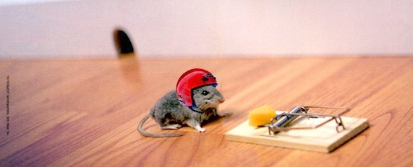
Notes:
29

Slide 30
How did CFT Start
Clinical observation of people struggling with standard therapies
Long focus on shame and self-criticism which are known to be linked to poor outcomes
Interest in basic evolved systems that regulate a range of psychological processes

Slide 31
What is helpful
Cognitive-Behavioural focused therapies help people distinguish unhelpful thoughts and behaviours - that increase or accentuate negative feelings - and alternative helpful thoughts and behaviours that do the opposite. This approach works well when people experience these alternatives as helpful. However, suppose they say, “I can see the logic and it should feel helpful but I cannot feel reassured by them” or “I know that I am not to blame but still feel to blame”.

Slide 32
Nature of the problem
Able to look at things in different ways – but don’t feel any better
Able to generate alternative thoughts – but don’t feel any better
Question:
What are the mechanisms that help people feel better?

Slide 33
Basic Philosophy is That:
We all just find ourselves here with a brain, emotions and sense of (socially made through evolution) self we did not choose but have to figure out
Life involves dealing with tragedies (threats, losses, diseases, decay, death) and people do the best they can
Much of what goes on in our minds is not of ‘our design’ and not our fault
We are all in the same boat
De-pathologising and de-labelling – understanding unique coping processes

Slide 34
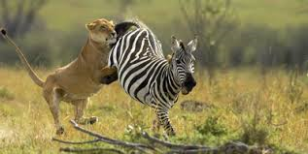
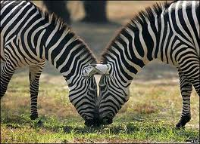

Why Zebras don’t get ulcers!
When danger has passed for an
animal their threat system switches off.
As humans, we can continue to
scare ourselves with our imagination,
worries and memories which keeps our
threat system highly activated after physical
danger has passed (Sapolsky, 1994).
(Tobyn Bell)

Slide 35
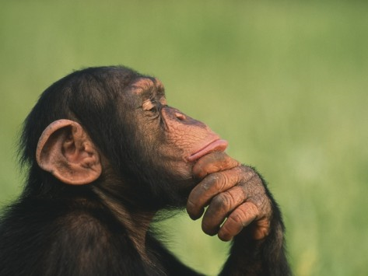
What if I can’t cope tomorrow?
Other animals haven’t evolved the ‘new brain’ areas that result in worrying about what will happen tomorrow or what happened yesterday
(Tobyn Bell)

Slide 36
Types of Affect Regulator Systems
Drive, excite, vitality
Content, safe, connected
Non-wanting/
Affiliative focused
Safeness-kindness
Soothing
Incentive/resource- focused
Wanting, pursuing, achieving, consuming
Activating
Threat-focused
Protection and
Safety-seeking
Activating/inhibiting
Anger, anxiety, disgust

Slide 37
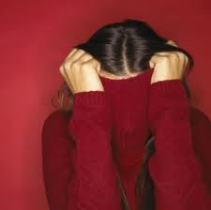

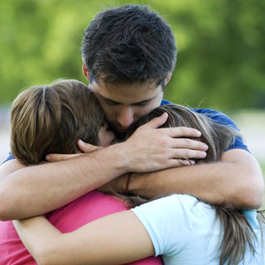
‘Brain-storming’ exercise
Consider what emotions, physical feelings, motives, behaviours and thoughts are associated with each of these systems
THREAT AND PROTECTION
DRIVE AND ACHIEVEMENT
SOOTHING AND CONNECTION
Tobyn Bell

Slide 38
"When faced with the pain of life, the threat system says, 'This is bad - I need to fight or run away!'
The drive system says, 'Things will be better when I have that!'
Compassion, intimately related to our safeness system, says, 'Ah, pain. I recognize you. This is how life sometimes is. I will figure out what needs to be done to work with this, and I will bear it in the meantime’’
Russel Kolts

Slide 39
Humans Have Easily Conditioned Threat System
Better safe than sorry: Notice threats quickly
Safety Strategies: Fight, flight, freeze, submit or attack
Social rank theory: social anxiety & depression
When aware of the social rank, status and power of others and when perceive self as inferior
Attention: highly sensitive to others’ verbal and non-verbal signals
Emotions: uncertainty, social anxiety/depression, anger, resentment
Behavior: Appease and avoid

Slide 40
Threat-focused
Protection and
Safety-seeking
Activating/inhibiting
Anxiety
Body/feelings
Tense
Heart increase
Dry mouth
“Butterflies”
Afraid
Attention/Thinking
Narrow-focused
Danger threat
Scan – search
Internal vs. external
(attribution prediction)
Behaviour
Passive avoidance
Active avoidance
Submissive display
Dissociate

Slide 41
Threat-focused
Protection and
Safety-seeking
Activating/inhibiting
Anger
Body/feelings
Tense
Heart increase
Pressure to act
Anger
Attention/Thinking
Narrow-focused
Transgression/block
Scan – search
Internal vs. external
(attribution prediction)
Behaviour
Increase outputs
Aggressive display
Approach
Dissociate

Slide 42
Menu of Protective/Defensive Emotions
Anger – increase effort and signal threat
Anxiety – alert to danger and select
Disgust – expel/keep away from noxious or undesirable
Sadness – acknowledge loss, signal distress
Jealousy – threaten and defend
Envy – undermine/spoil benefits of the other
(Tobyn Bell)

Slide 43
Automatic threat/protection strategies found in nature
Subdue others Frighten others as deterrent
Control others Isolate Escape
Turn away Hide ‘Play dead’
Cling on to Seek protective others Avoid
Camouflage Fit in with the group Comply
Submission Hyper-vigilance Predict threat early
How do these strategies look in humans?
(Tobyn Bell)

Slide 44
Consider what might be in each area: e.g. in a threat mind-set where would your attention be?
How the threat system organises our mind
Attention
Emotional experience
Thinking and reasoning
THREAT:
‘I’m in danger!’
Imagery and fantasy
Motivation
Behaviour

Slide 45
Consider what might be in each area: e.g. in a drive mind-set what would your motivation be?
How the drive system organises our mind
Attention
Emotional experience
Thinking and reasoning
DRIVE:
‘I want that!’
Imagery and fantasy
Motivation
Behaviour

Slide 46


The Mammalian Importance of Caring Minds
Caring as ‘looking after’. Seeking closeness rather than dispersion. Individuals obtain protection, food, and care when ill. Key also is soothing-calming and physiological regulation. Few offspring but high survival rate in comparison to species without attachment, affection and kindness
Co-operative and mutual support can develop as we see that our prosperity impacts on that of others, sharing and not-exploiting
Notes:
46

Slide 47
Consider what might be in each area: e.g. in a soothing mind-set what would your emotional experience be?
How the soothing system organises our mind
Attention
Emotional experience
Thinking and reasoning
SOOTHING:
‘I am valued and connected’
Imagery and fantasy
Motivation
Behaviour

Slide 48
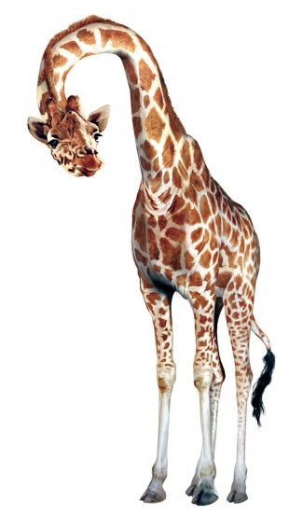
Evolved strategies
We evolve strategies to cope
with our social environment and
circumstances. It’s a bit like how
animals have evolved over
thousands of years. We
develop specifically to
suit our environment.
Evolved strategies often
have ‘trade-offs’ and come with
unwanted side-effects!
(Tobyn Bell)

Slide 49
Socially Anxious Example
Past Experiences: critical mother, distant father, bullied at school,
shame based memories
Key Fears/Threats: fear of rejection and failure, feeling alone, vulnerable
Protective Coping Strategies: appease others, try to be liked, suppress feelings and needs, criticize self
Unintended/Unwanted Consequences: Own needs ignored, feel put upon, angry, not achieve personal goals, lose sense of self, feel fragile (adapted from Tobyn Bell)

Slide 50
Source of threat
External
Shared with other animals focus on the outside and how to behave in the outside world to minimize threat and harm
Internal
Can be threatened by the emergence of internal emotions, desires fantasies and memories
Both can be very clear or very subtle threats

Slide 51
External and internal threats
For example, a person attending a social event might fear:
being rejected by the people there (external threat)
also worry about being overwhelmed with anxiety (internal threat).
Such threats often interact: e.g. the same person might fear their anxiety will become so overwhelming that other people will notice and criticise them (external threat).
The protection strategies for internal and external threats can be different. Coping might include:
being non-assertive and people pleasing (external)
using alcohol to reduce anxiety (internal).
(adapted from Tobyn Bell)

Slide 52
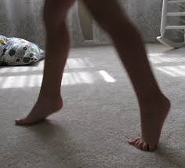

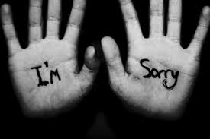
Self-monitoring and self-blame as protection
Self-monitoring and self-blame can be used to appease someone we see as more powerful than us, as a means to stay safe and out of harm. If, for example, a bully or a parent’s behaviour is frightening and unpredictable we might try and tip-toe around them like they are a sleeping tiger. When we do arouse their negative attention we might be cross at ourselves for increasing our vulnerability or the risk of attack.
If we cannot control or influence the behaviours of important others, we might begin to keep a tight watch over our own actions and emotions, blaming ourselves severely for mistakes. Blaming the other person might be too scary or dangerous, especially for a child. (Tobyn Bell)

Slide 53
COPING STRATEGY Examples | INTENDED CONSEQUENCES | POSSIBLE UNINTENDED CONSEQUENCES OR DRAWBACKS
Always putting on a brave face
Be as others want
Withdrawing from other people
Avoid situations where I can ‘fail’
Drinking alcohol to cope
Trying to be perfect
Analysing and going over my mistakes
Preparing for the worst/ worrying

Slide 54

CHAIR EXERCISE
Write down some recent examples of your own self-criticism. Try and remember a situation when you gave yourself a hard time: what did you say or feel towards yourself?
Read these criticisms out loud to an empty chair, imagining someone else is sitting there. How you think a person in the chair might feel or respond?

Slide 55
COMPASSIONATE SELF-CORRECTION | SHAME BASED SELF-ATTACKING
-Focuses on the desire to improve -Focuses on growth and enhancement -Is forward-looking -Is given with encouragement support and kindness -Builds on positives (e.g. seeing what one did well and then considering learning points) -Focuses on attributes and specific qualities of self -Focuses on and hopes for success -Increases chances of engaging | -Focuses on the desire to condemn and punish -Focuses on punishing past errors -Is often backward looking -Is given with anger, frustration, contempt, disappointment -Focuses on deficits and fear of exposure -Focuses on a blaming whole self -Focuses on high fear of failure -Increases chances of avoidance and withdrawal
FOR MISTAKES | FOR MISTAKES
-Guilt, engage with feelings -Sorrow, remorse -Reparation Example: the encouraging/supportive teacher with the child who is struggling | -Shame, avoidance, fear -Heart-sink, lowered mood -Aggression Example: the critical teacher with the child who is struggling

Slide 56
Compassionate Mind-Self
SKILLS -TRAINING
WISDOM
WISDOM
Imagery
Attention
ATTRIBUTES
Reasoning
Sensitivity
Sympathy
STRENGTH
Distress tolerance
STRENGTH
Care for
well-being
Compassion
Non-Judgement
Empathy
Behaviour
Feeling
Sensory
COMMITMENT
COMMITMENT
Notes:
56
56

Slide 57
Key Imagery Tasks
Soothing breathing rhythm
Safe ‘welcoming’ place
Compassion colour
Compassionate self
Compassionate other/image
Building and strengthening the compassionate mind as building capacity to think and feel compassionately

Slide 58
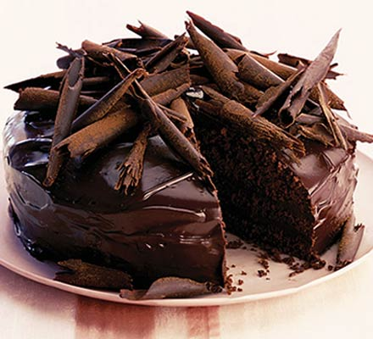
Why imagery?
Imagery has been shown to be more emotionally powerful than verbal expressions
VERBAL: Chocolate Cake
or
        IMAGINAL:
Tobyn Bell

Slide 59
Imagery
Exercise: Desire to be at peace
May I be happy, may I be well, may I be at peace
Exercise: Using memory
Remember a time someone was kind, caring, and warm toward you
Remember a time you were kind, caring, and warm toward someone in distress
Exercise: Desire that others be at peace
May you be happy, may you be well, may you be at peace
Soothing breathing rhythm:
Safe ‘welcoming’ place
Notes:
Try this now

Slide 60
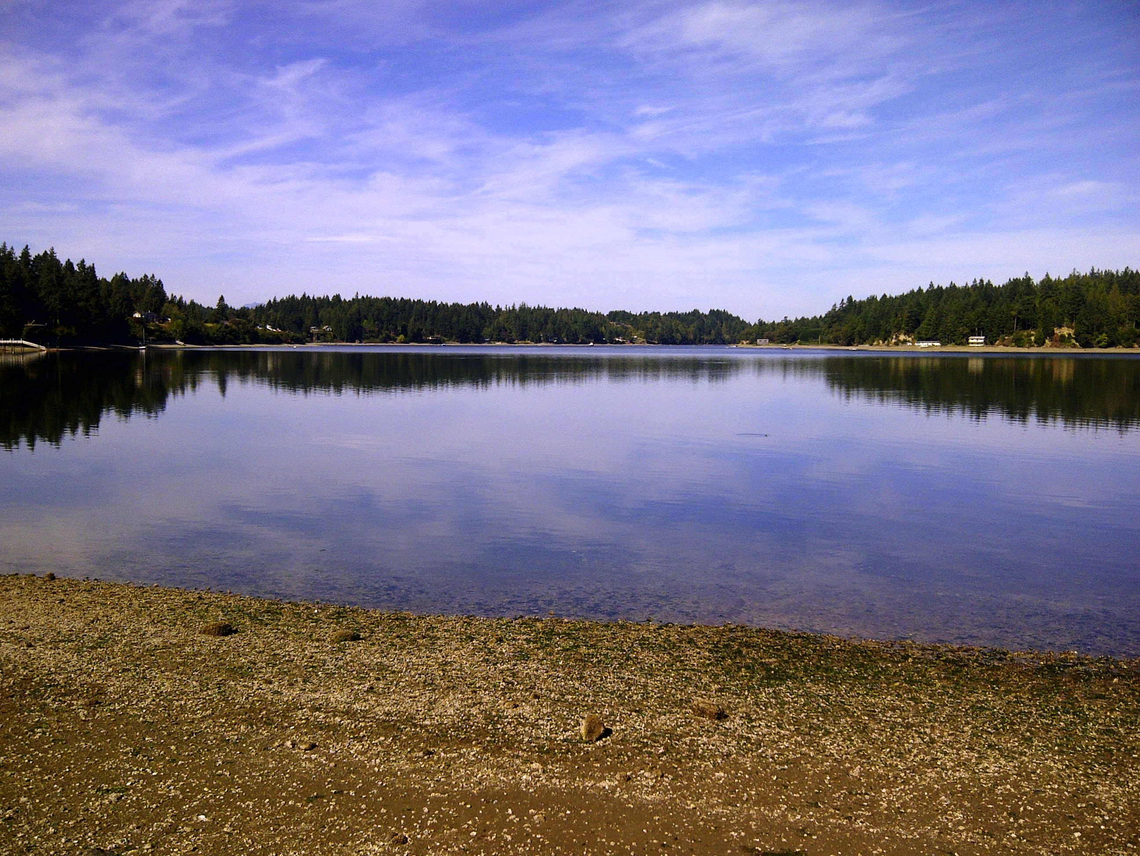
Your Safe Place
Safe ‘welcoming’ place
Lower or close the eyes
Find your soothing rhythm breathing
Imagine a place that gives you feelings of safeness, calm and contentment, perhaps a quiet room, a beach, or in the woods
Focus on the details and use all five senses: what you see, touch, hear, smell, taste
Your safe place welcomes you and enjoys having you there. It is your own, you belong there and can rest. Feel the safeness and connection; feel its welcome.
When ready, opening the eyes
Notes:
Try this now

Slide 61
Developing Compassion Images
Ideal caring and compassionate self and/or other --- define ideal as everything you would want, need
Wisdom a sentient mind who understands the struggles of humanity and self. Empathic stance, self-transcendent
Strength as ‘calm authority’ fortitude, endurance, complete benevolence
Caring as a genuine desire for one’s well-being –Commitment and motivation
  Include compassionate attributes

Slide 62
Compassionate Mind-Self
SKILLS -TRAINING
WISDOM
WISDOM
Imagery
Attention
ATTRIBUTES
Reasoning
Sensitivity
Sympathy
STRENGTH
Distress tolerance
STRENGTH
Care for
well-being
Compassion
Non-Judgement
Empathy
Behaviour
Feeling
Sensory
COMMITMENT
COMMITMENT
Notes:
62
62

Slide 63
Imagery
Non-verbal Communication
Compassionate facial expression – smile
Compassionate voice – tone, form and pace
Compassionate posture (e.g. can change depending on the actions)
Sense of appearance, and colour (e.g. clothes)
    Method Acting for compassionate self
Sensory qualities help form image

Slide 64
Imagining the Compassionate Other/Self
Explain point of Compassionate-other/self imagery work
Inner helper, inner guide, access to self-soothing system through relating to self or other (no different in principle to activating any other system e.g. sexual – these systems were designed for social interactions – social mentality theory (Gilbert, 2000; Fonagy & Target, 2006))
Now for a moment, focus on your breathing and try to feel soothing rhythm. Look down or close your eyes and imagine your image of your compassionate ideal ‘other’ caring for you.
Useful specific questions: would they be old or young, male or female, colour of their eyes, tall or short – more than one
Notes:
64
Now do the compassionate ideal other

Slide 65

Compassionate letter writing
Try and write a letter to yourself from a compassionate standpoint (using your compassionate-self). Alternatively, try and imagine hearing the words of your compassionate coach or your friend
Remember your compassionate motivation: to alleviate suffering and bring support.
Acknowledge and validate your emotions and experiences
(e.g. ‘I am currently feeling…’)
Offer yourself understanding (e.g. ‘It’s understandable I feel….’)
Bring warmth and kindness (e.g. ‘Experiencing this is hard’)
Understand our common humanity (e.g. ‘It’s normal for a person to feel this….I’m not alone’)
Provide encouragement and strength (‘You can manage this’)
Try and provide some gentle advice (‘Maybe try…’) (Tobyn Bell)

Slide 66
When writing a letter, consider the skills and attributes of compassion
Skills
Attention: Where would it be helpful to place your attention?
Imagery: Can you use your compassionate imagery to support you?
Thinking and reasoning: Try and consider your experience from a compassionate perspective. Can you consider a balanced view?
Behaviour: What do you need to do to support yourself?
Feelings/emotions: Can you convey feelings of warmth and connectedness
Motives: Try and write the letter with a motivation to support yourself
Attributes
Sensitivity: What are you feeling at this moment?
Sympathy: Allow yourself to be moved by your experience
Distress tolerance: Remind yourself of your strength and courage
Empathy: Offer yourself understanding
Non-judgement: Try and avoid criticism. Try and validate your experience
Care for well-being: Offer yourself encouragement and care (Tobyn Bell)

Slide 67
Threat Processing
Threat processing cannot be understood in single domains of cognitive, behavioural, physiological but are complex multi-modal brain states
Threat processing (often) cannot be focused on single emotions, e.g. anxiety but combination and conflicts of emotions
Threat emotions can have conscious and non- conscious attributes
Need to work in multimodal domains

Slide 68
Threat relations
Conflicts of Emotions
blocks
Anger
Anxiety
blocks
blocks
Sadness
Each emotion can have a variety of defensive behaviours and memories

Slide 69
Emotions Fusion
Emotions that we experience together can ‘wire’ together –basic conditioning model
A child is hit ( fear) then sent to their room (loneliness-no rescue). Fear and loneliness become fused. Therapists sometimes miss the importance of loneliness as a core emotion to work with while engaging with fear.
Anger and fear also a common fusion
-Emotional Schemas (Robert Leahy)

Slide 70
Emotional Schemas (Robert Leahy)
Can develop threat-based beliefs and coping strategies for emotions and desires that emerge from how we experience our own emotions and others’ responses to them.
Emotions can become threats themselves related to beliefs that one’s desires, fantasies and emotions are incomprehensible, unique to the self, shameful, can never be validated or expressed and /or that one’s emotions will go out of control if experienced. Beliefs that one should be rational and logical all the time, never have conflicting feelings, and should ruminate in order to figure things out. Ruminations can be a way to try to work things out without needing help (soothing) from others.

Slide 71
Threat Emotions and Conflicts
Threat – boss criticises your work
Rapid access of threat-safety strategies
Angry-attack revenge
Anxious - flee submit
Cry want to seek reassurance
Threat to self-identity and self as social agent in social role
Problems can occur when different emotions arise at similar time, or when one emotion triggers another – can leave us feeling confused: ‘I don’t know what I feel‘ Take time to explain that to clients about emotional conflicts – ‘tricky brains’

Slide 72
Exercise
Imagine an argument with someone you care for:
Now focus on different voices and parts
What does your:
angry part think, feel and want to do?
anxious part think, feel and want to do?
sad part think, feel and want to do?
Do they turn up at different times and conflict?
Build the compassion self

Slide 73
Multi-Mind and Multiple Patterns
Thoughts
Body
Actions
Memories
Thoughts
Body
Actions
Memories
ARGUMENT
Thoughts
Body
Actions
Memories
Thoughts
Body
Actions
Memories
Link to fears and memories
Notes:
Add memories on each slide

Slide 74
Multi-Mind and Multiple Patterns
ANGRY
Blame them
They shouldn’t have done that
Get my own back
ANXIOUS
What if it is partly me?
They might not like me now
Appease
ARGUMENT
SADNESS
Damaged the relationship
Loss
Withdraw
COMPASSION
Mindfulness and stand back
Mentalize and validate
What would be helpful
Kind voice - stillness

Slide 75
Process of Multi Self
All our minds have these parts – helpful to get to know them better –
Aiding emotions discrimination and awareness of conflicts of emotions as ‘normal’ and common.

Slide 76
Compassion for the threat Systems

Slide 77

Fears of Compassion
Remember: Compassion focused therapy targets the activation of the soothing system (to gain positive affect) to connect thoughts with the emotional experience referred to by those thoughts.
Compassion can be threatening. Clients can be afraid of compassion toward the self, from others and for others.
Gilbert, P., McEwen, K., Matos, M., & Rivis, A. (2011). Fears of compassion: Development of three self-report measures. Psychology and Psychotherapy: Theory, Research and Practice 84, 239-255.

Slide 78
Jane: Fear of Compassion/Self
Expressing kindness, compassion toward self (rated 4; 0-4)
If I really think about being kind and gentle with myself it makes me sad.
I fear that if I start to feel compassion and warmth for myself, I will feel overcome with a sense of loss/grief.
I fear that if I become too compassionate to myself I will lose my self-criticism and my flaws will show.
Notes:
Jane College students
(N=222)
0 – 4 M = 2.8 Total = 42 Avg. = 16.1 (SD 10.4)

Slide 79
Jane: Fear of Compassion/Others
Responding to compassion from others (rated 4; 0-4)
I’m fearful of becoming dependent because they might not always be available or willing to give it.
If people are friendly and kind I worry they will find out something bad about me that will change their mind.
When people are kind and compassionate towards me I feel empty and sad.
Notes:
Jane College students
0 – 4 M = 3.6 Total = 47 Avg = 15.8 (SD 7.8)

Slide 80
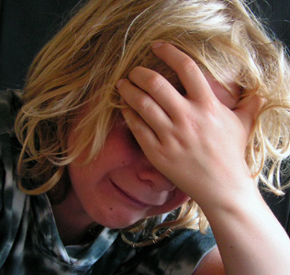
(with permission, Paul Gilbert)

Slide 81
Countering Fear of Compassion
Acknowledging strengths:
Empathy toward her dog, the abandoned student, neighbor, her parents
Continuing to build empathy toward her own distress:
Continuing to normalize shame, encourage self-disclosure, active listening, reflecting emotions, writing exercises (Kristen Neff)
Two chair exercises:
Protective self and the hopeful, trusting self
Self critical self and compassionate self-correcting self
Critical self and empathic self (to her own and others’ distress)

Slide 82

(with permission, Paul Gilbert)

Slide 83
Compassion Focus
Empathy and sympathy for one’s own distress
Awareness with out-judgement or blame
Refocus/activate safe-conferring processing systems
Compassionate attention, thinking, behaviour
Generate compassionate feeling (warmth)
Use images and sensory experiences
Key focus is “finding what is experienced as
helpful, kind and supportive in this moment”

Slide 84
Compassionate Mind - Alleviation
SKILLS -TRAINING
Warmth
Warmth
Imagery
Attention
ATTRIBUTES
Reasoning
Sensitivity
Sympathy
Compassion
Distress tolerance
Care for well-being
Feeling
Empathy
Behaviour
Non-Judgement
Sensory
Warmth
Warmth
Notes:
84
84

Slide 85
Three Compassionate Cycles
Face fear
Accept self
Accept others
Accept fear
Support self
Support others
Act through
emotion
Self-compassion
Compassion
toward others
Acceptance
Compassion
Forgiveness
Notes:
Lynne
SAY:
Putting it all together: We accept our fear and act in the face of it. We accept ourselves and others, with all our imperfections, extending to both ourselves
and others compassion and forgiveness and a willingness to continue to engage in conversation until we understand each other better and can help each other be
the best that we can be as we work together.(do good work together?)

Slide 86
Some Useful Websites
www.compassionatemind.co.uk
www.compassionatewellbeing.com
www.mindfulcompassion.com
www.self-compassion.org
www.ccare.stanford.edu
www.mindfulselfcompassion.org
www.mindandlife.org

Slide 87

Further reading
John Cacioppo & William Patrick – Loneliness: Human nature and the need for social connection
Chris Germer- The mindful path to self-compassion
Paul Gilbert- The compassionate mind
Paul Gilbert & Choden – Mindful Compassion
Lynne Henderson-The compassionate mind guide to building social confidence
Lynne Henderson – Helping your shy and socially anxious client: A Social Fitness Training protocol using CBT
Russell Kolts- Managing your anger using compassion focused therapy
Deborah Lee- Recovering from trauma using compassion focused therapy
Kristen Neff- Self compassion
Mary Welford- Building your self-confidence using compassion focused therapy

Slide 88
Remember…….
The future depends on what we do in the present.
Mahatma Gandhi
Try not to become a man of success but a man of value.
Albert Einstein
Notes:
The future depends on what we do in the present.
Mahatma Gandhi
Try not to become a man of success but a man of value.
Albert Einstein
If any of you in the audience questions your leadership ability because you are shy, trust me, we need you. The rest of us need to make sure that everyone participates. The responsibility is ours. We can cooperate as well as compete. A quiet revolution may be in process.

Slide 89
Thank you
Contact information:
  Lynne Henderson, Ph.D.
  Director, Shyness Institute
  Director, Social Fitness Training, Courageous Leadership,LLC
  Author: Building Social Confidence using Compassion Focused Therapy and
  Helping your shy and socially anxious client: A Social Fitness Training protocol using CBT
  lhenderson@rivcons.com
  clinic@shyness.com
  www.shyness.com
  www.thecourage2lead.com

